Slide 1




FitGenius
2024
:D
Software
Design
FitGenius
Team #3

Slide 2





FitGenius
2024
:D
Team Members
Project Lead
Arpa
Hakopian
Isai
Flores
Emanuel
Diaz
Sergio
Garcia
Mirna
Farahat

Slide 3
FitGenius
2024
:D
01
Scope
Project Goal: Develop an iOS fitness app that uses AI for personalized health and fitness support.
Key Features:
AI-driven workout plans, meal suggestions, and injury prevention.
Gamification through rewards for completing challenges, used for avatar customization.
Target Audience: Individuals aiming to improve their lifestyle and reach fitness goals.
Core Elements:
AI chatbox, fitness and nutrition tracking, and avatar personalization.
Document Overview:
Objectives, architecture, design, user interface, and security considerations.
Notes:
The project aims to develop an iOS fitness app that leverages AI to provide users with personalized workout plans, nutrition guidance based on the ingredients in their fridge, and injury prevention support. The app also fosters social interaction, allowing users to connect with friends, track each other's progress, and participate in challenges together. Completing challenges earns rewards that can be used to customize avatars, adding a gamified aspect to the experience. Targeted at anyone seeking to improve their lifestyle and achieve fitness goals, the app includes core features such as an AI chatbox, fitness and nutrition tracking, social connectivity, and avatar personalization. This document outlines the system's objectives and scope, detailing the high-level and system architecture, design elements and modules, design patterns, user interface and database design, and security considerations.

Slide 4
FitGenius
2024
:D
02
System Overview
Purpose:
FitGenius is a mobile fitness and nutrition tracking ios application designed to help users achieve their healthy and wellness goals through personalized plans, and activity tracking.
Provides an interactive and motivational platform for users to track their progress and stay committed to their fitness journey.
Functionality:
FitGenius enables users to monitor their fitness activities, customize fitness goals, and receive tailored recommendations.
Incorporates game-like elements to encourage engagement, such as avatar customization and reward systems.

Slide 5
FitGenius
2024
:D
02
System Overview
Main Features:
Fitness and Nutrition Tracking
Log Workouts, steps, and calorie expenditure
Personalization
Customized workout plans and meal recommendations for exercises, meal ideas, and healthy habits.
3. Gamification
Earn rewards and badges for milestones.
Customize avatars to reflect fitness progress.
4. Data Integration
View detailed analytics on fitness progress.

Slide 6

FitGenius
2024
:D
03
High-Level Architecture
Goal: create a clear architecture that addresses key aspects of the app’s functionality
User Experience - User interface that could adapt to user input.
Modularity and Scalability - breaking the app into different layers.
Separation of Concerns - each layer is responsible for a specific set of tasks.
Why?
Clarity - Shared understanding of the app’s architecture.

Slide 7
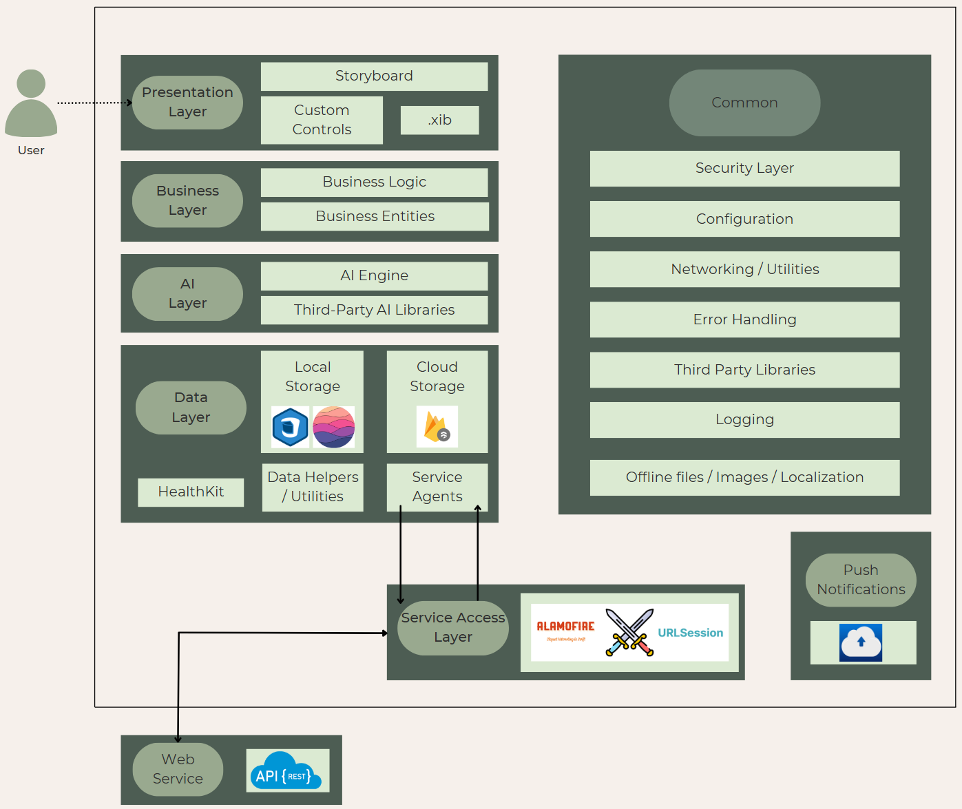
High - Level
Architecture
Diagram

Slide 8
FitGenius
2024
:D
04
Design Elements and Modules
Data Module
Handle data storage and retrieval from Firebase cloud storage
Integrate with the Health app to retrieve fitness data such as steps
Store and manage user data such as workout history and meal suggestions
Service Access Module
Handle the communication with Firebase for user authentication and data storage
Separates tasks such as AI data handling,data storage, and user authentication to keep a modular and organized approach

Slide 9
FitGenius
2024
:D
04
Design Elements and Modules
AI Module
Powers the AI chatbot for creating personalized workout and meal suggestions
Integrates the third party AI libraries to process user requests, filter unsafe requests, provide tailored recommendations to user
Presentation Module
Manages the user interface and user experience, including the screens for workouts
Display avatar customization and milestone rewards

Slide 10
FitGenius
2024
:D
05
Design Patterns
MVC
Split into 3 components: Model, View, and Controller
Will keep code organized by separating responsibilities
Model: Manage the apps data and core functionality
View: Handles the user interface which will display chatbot responses, avatar, etc
Controller: The layer between the model and view, processes user input and updates the view
Real-world example: A user inputs a fitness goal
Controller: Receives the users input and sends it to the Model
Model: Checks the input, saves it to storage, and sends confirmation to the Controller if valid
View: Updates display after Controller receives confirmation from the Model

Slide 11
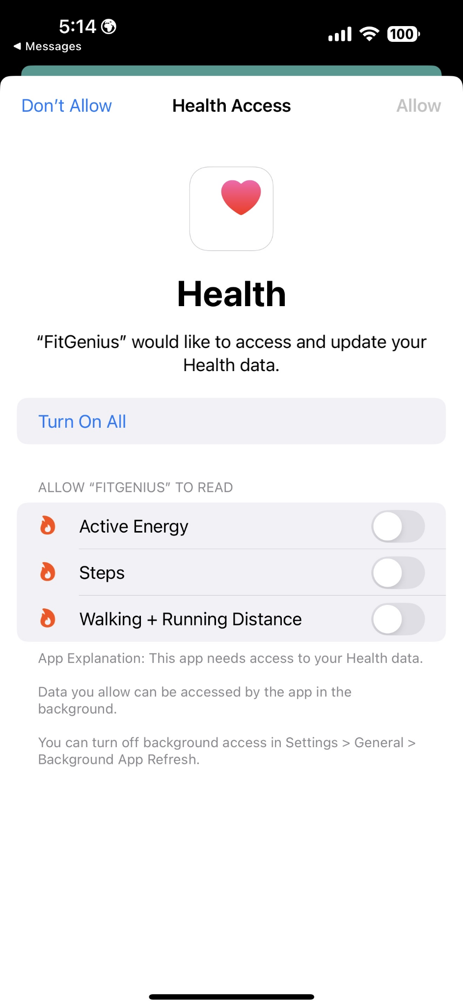
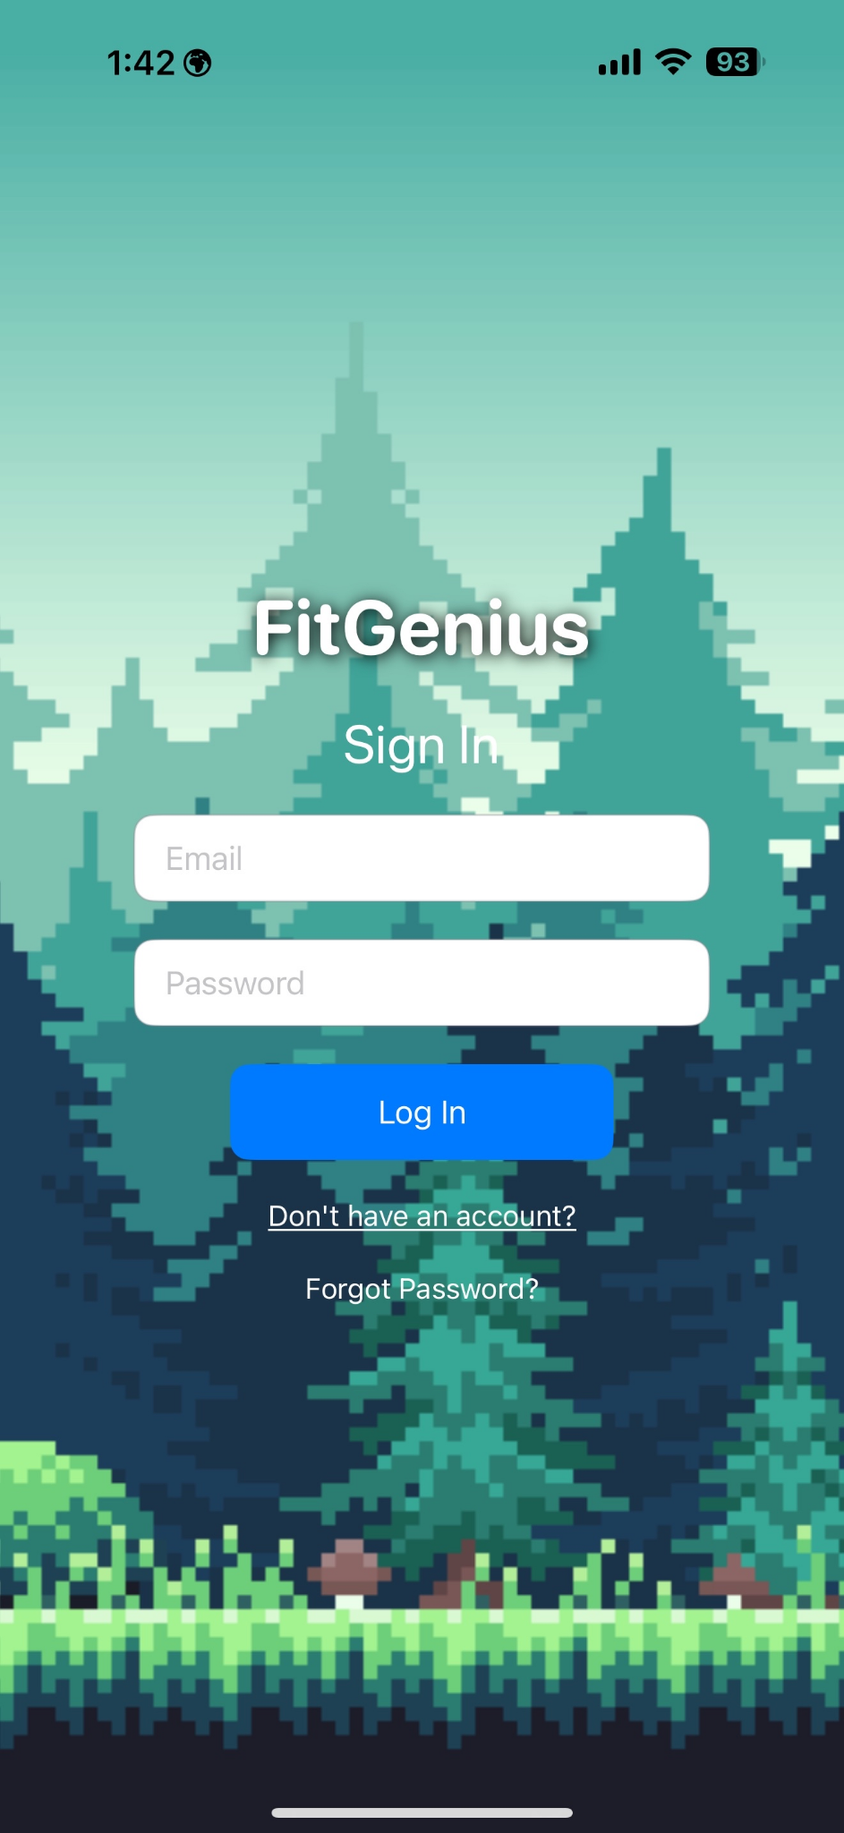
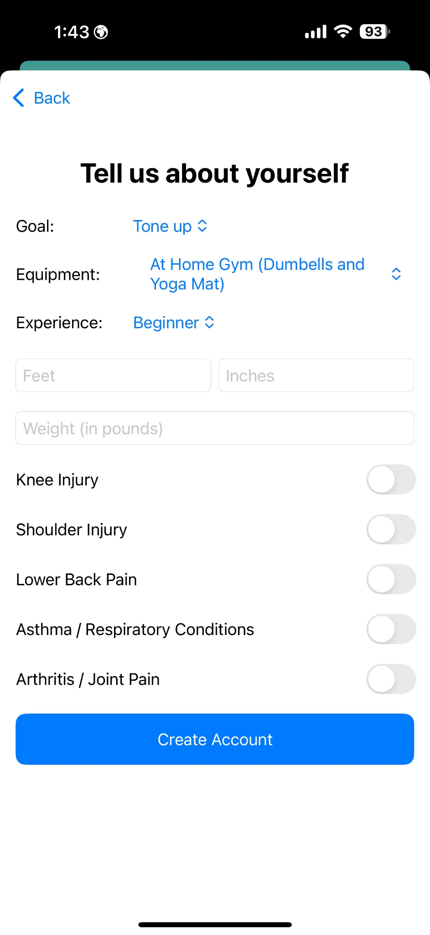

FitGenius
2024
:D
06
User Interface Design

Slide 12
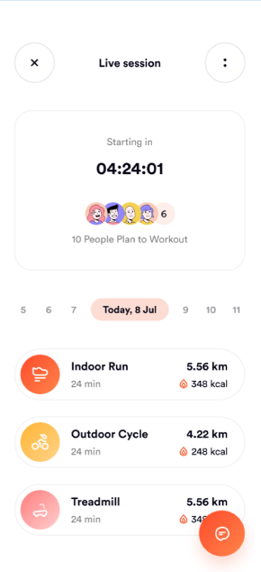
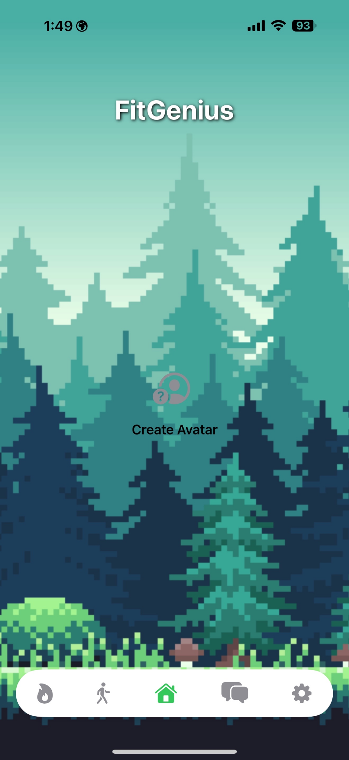
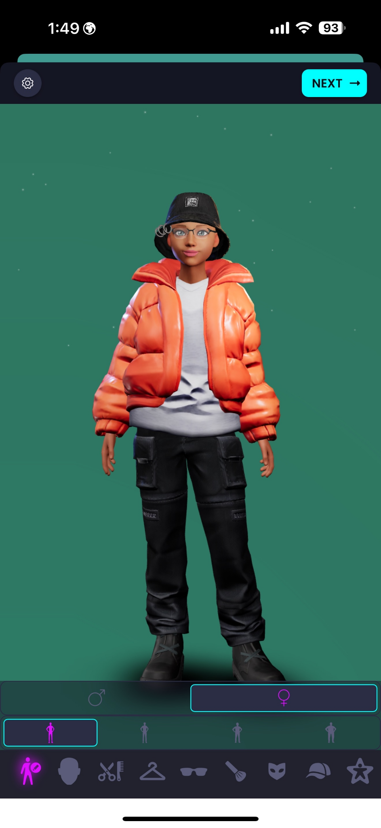
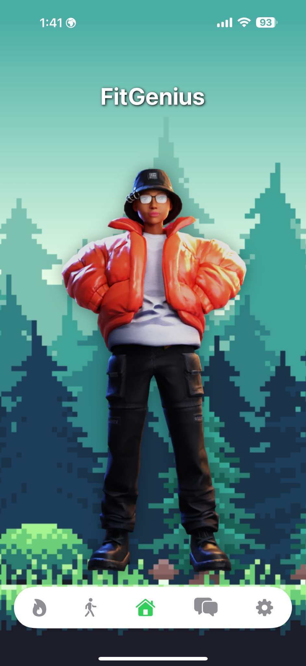
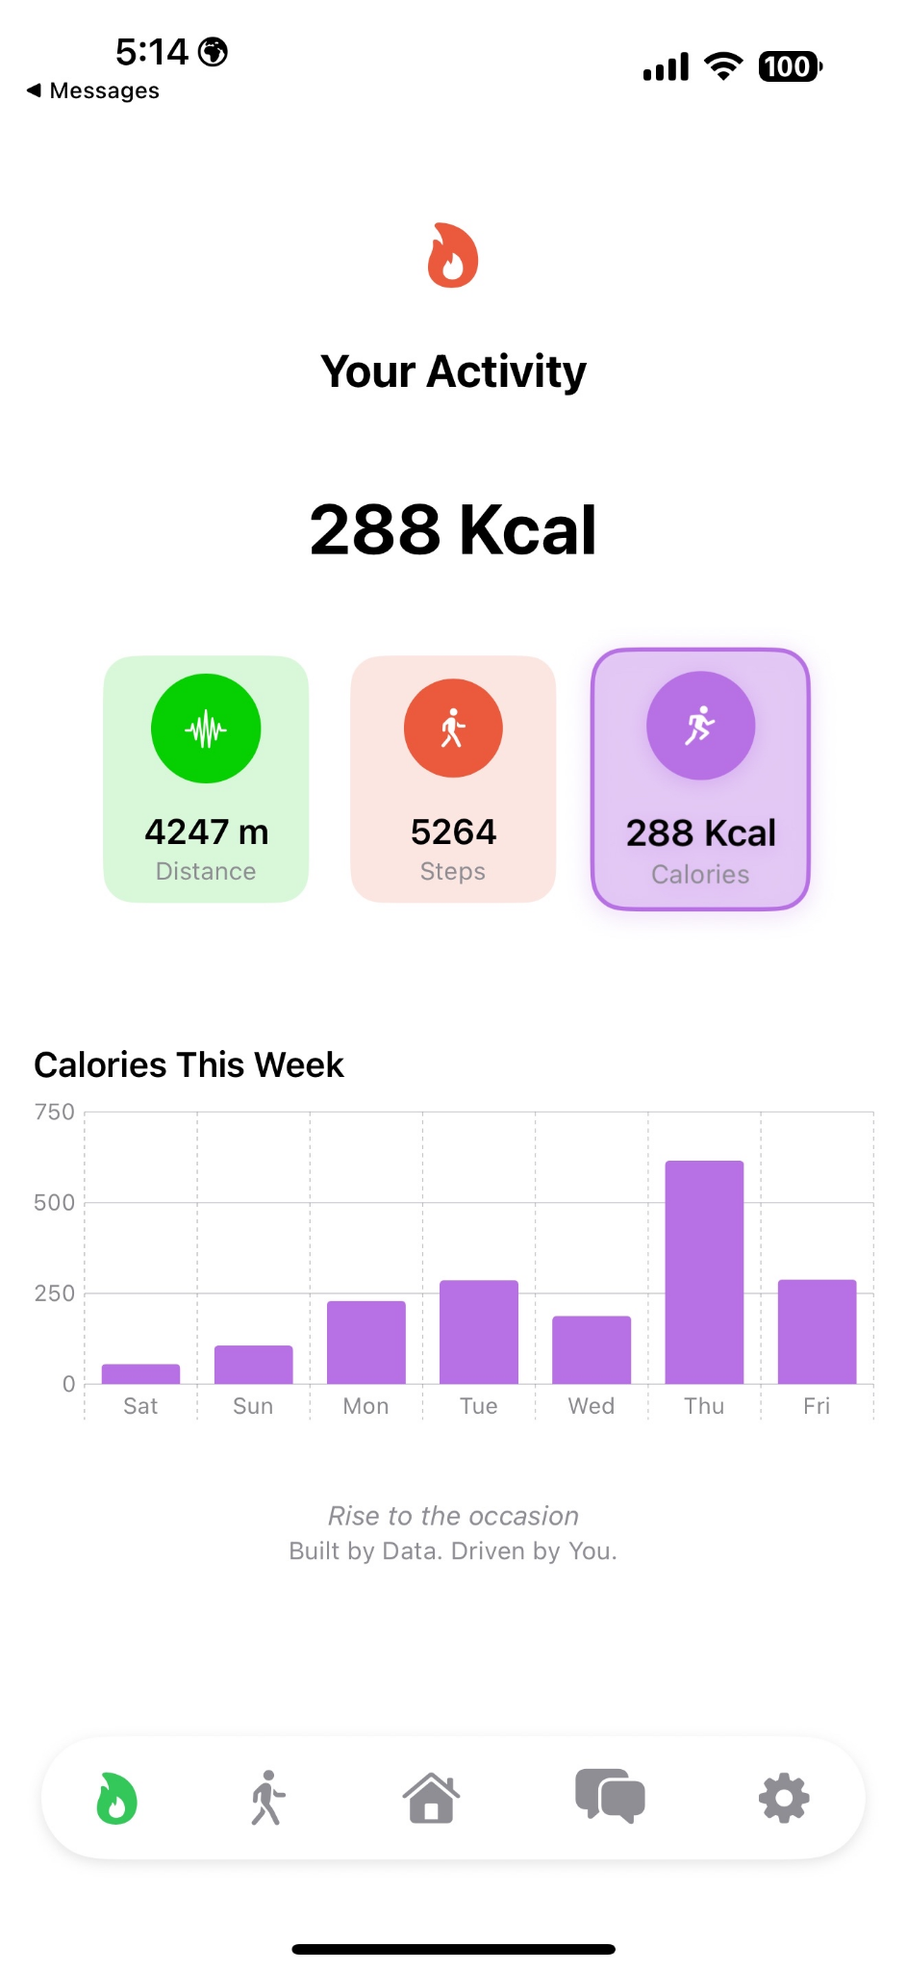
FitGenius
2024
:D
06
User Interface Design

Slide 13
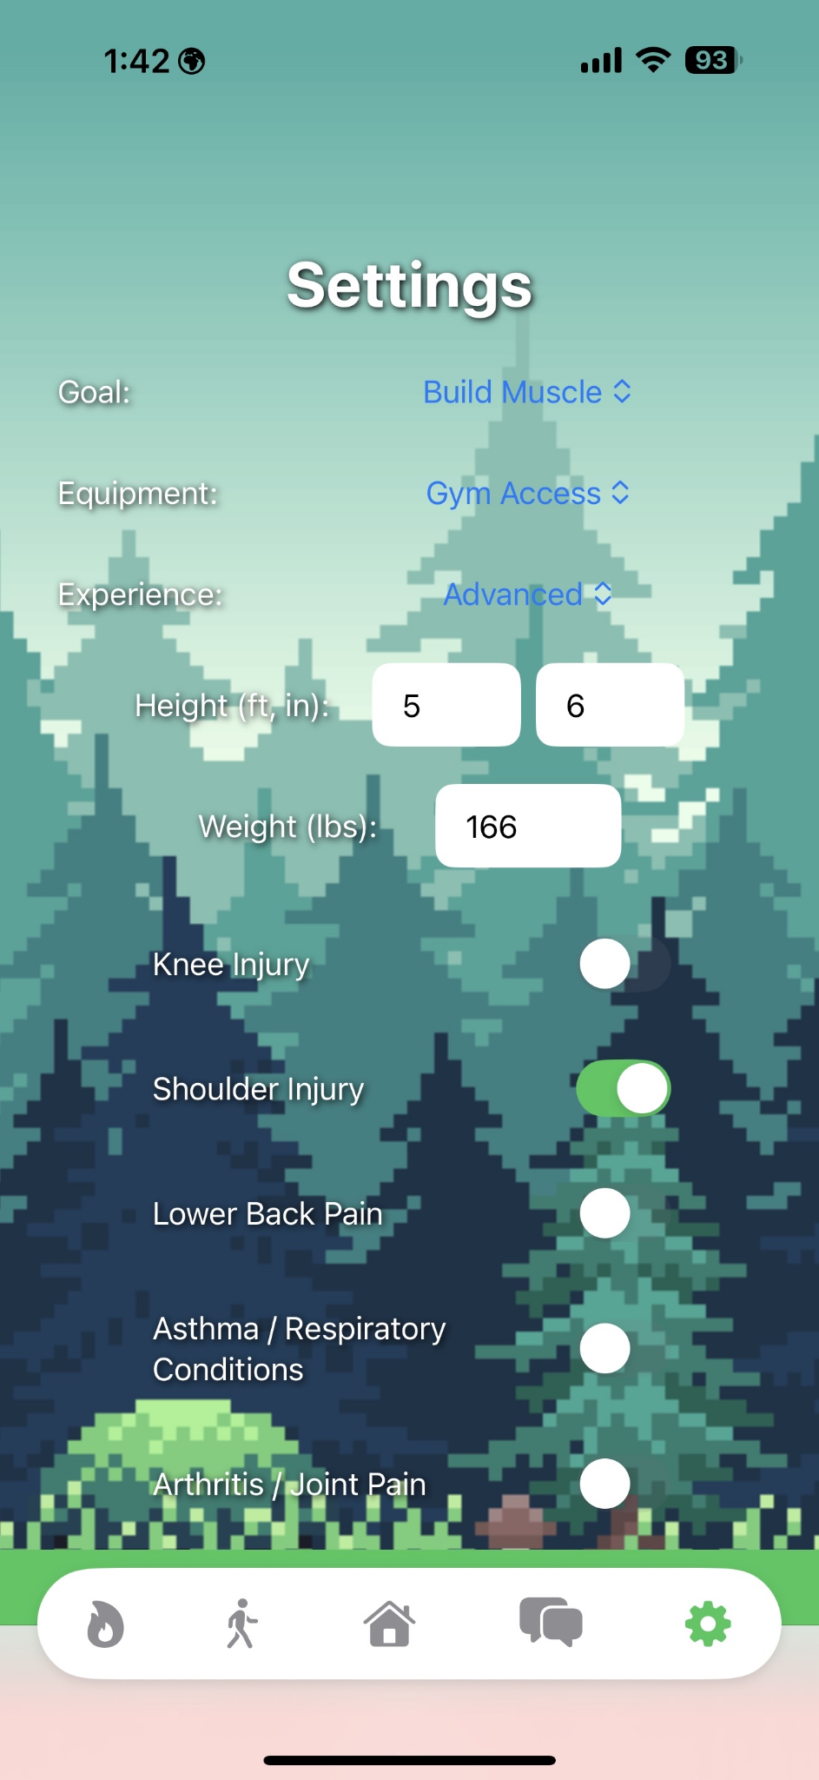
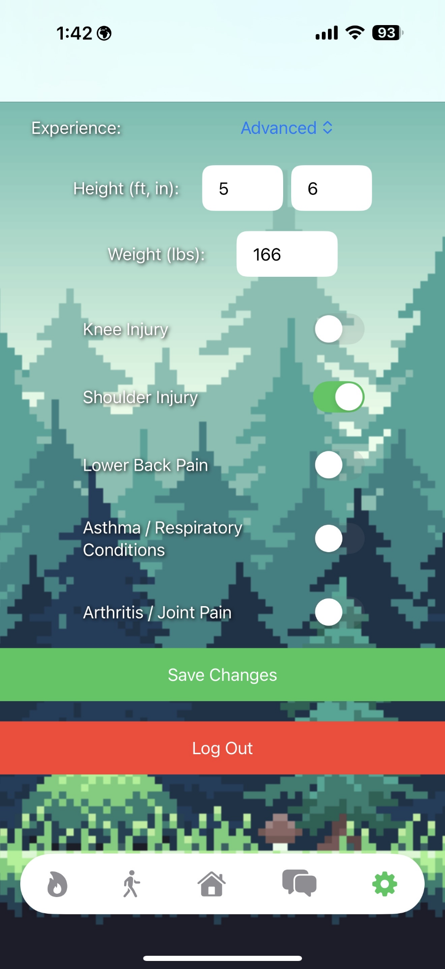
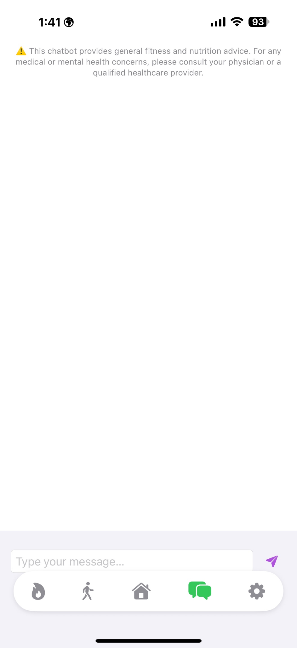
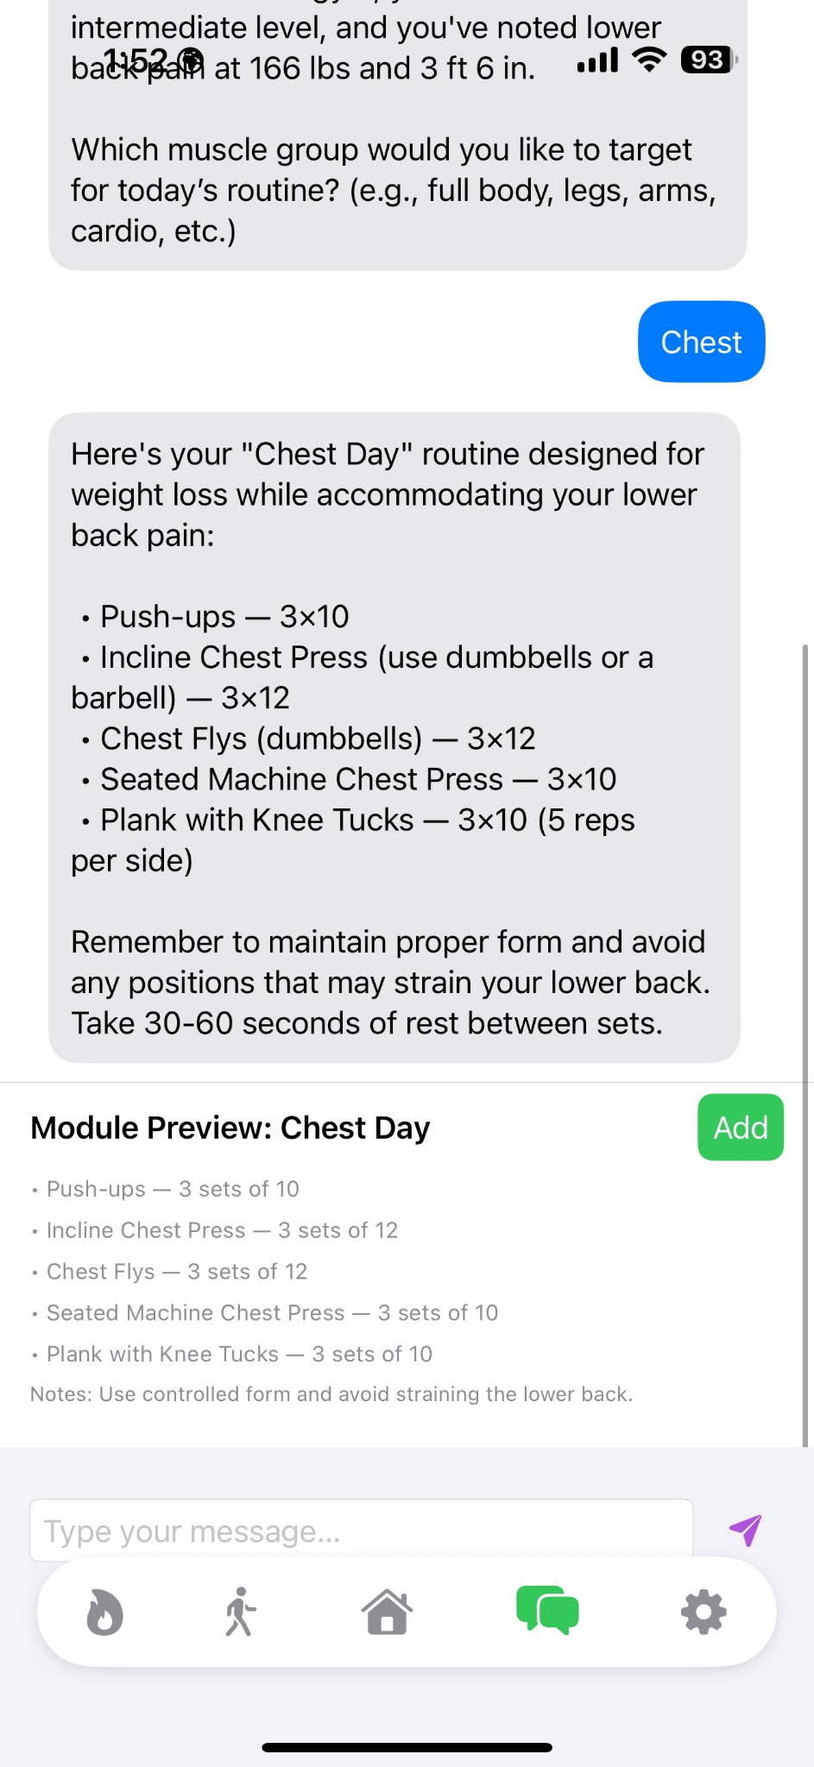
FitGenius
2024
:D
06
User Interface Design

Slide 14
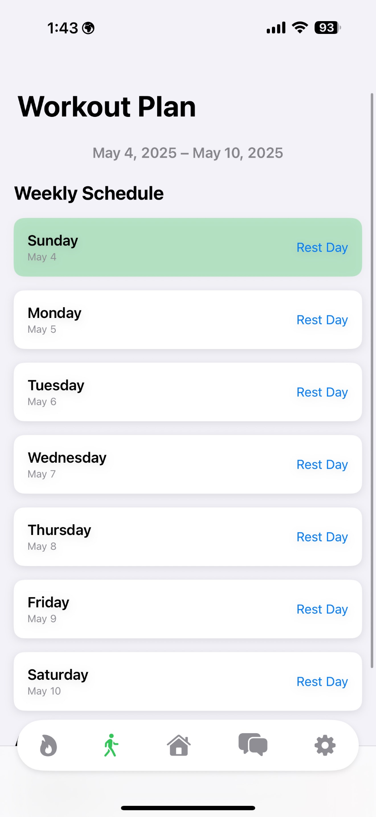
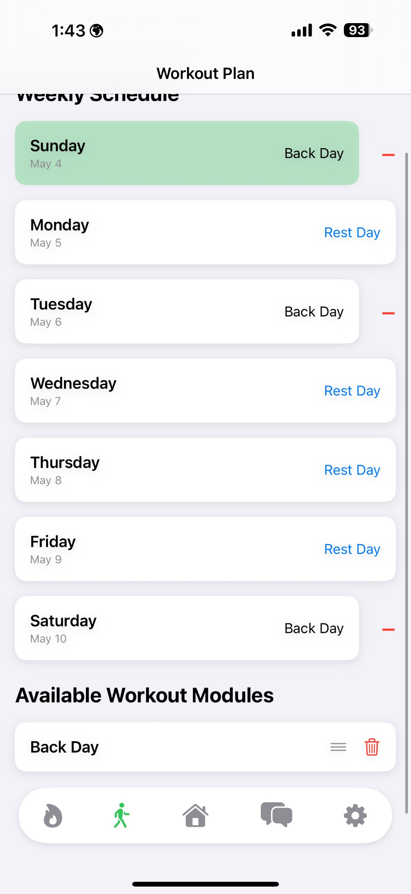
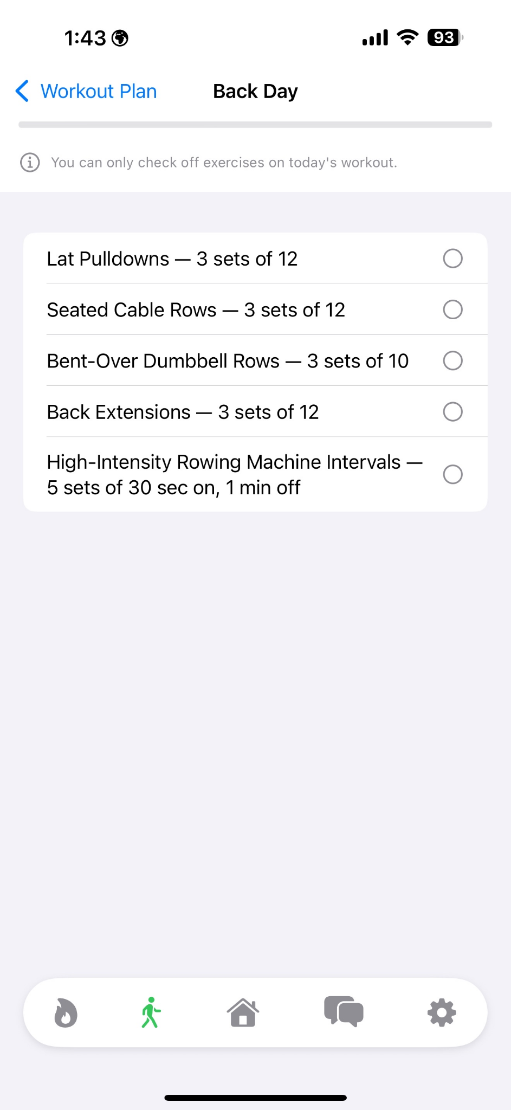
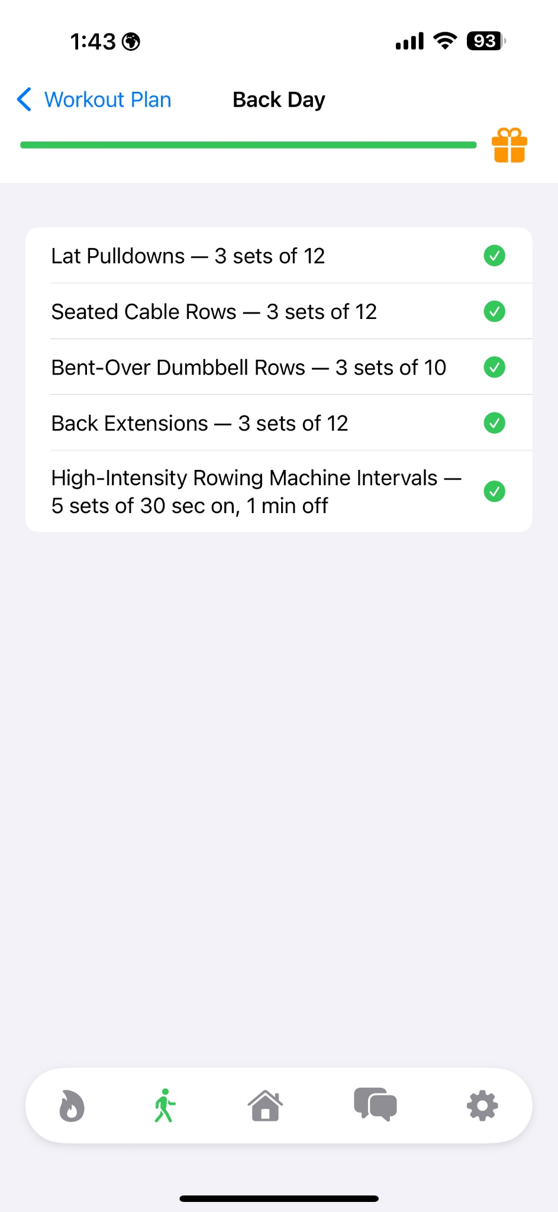
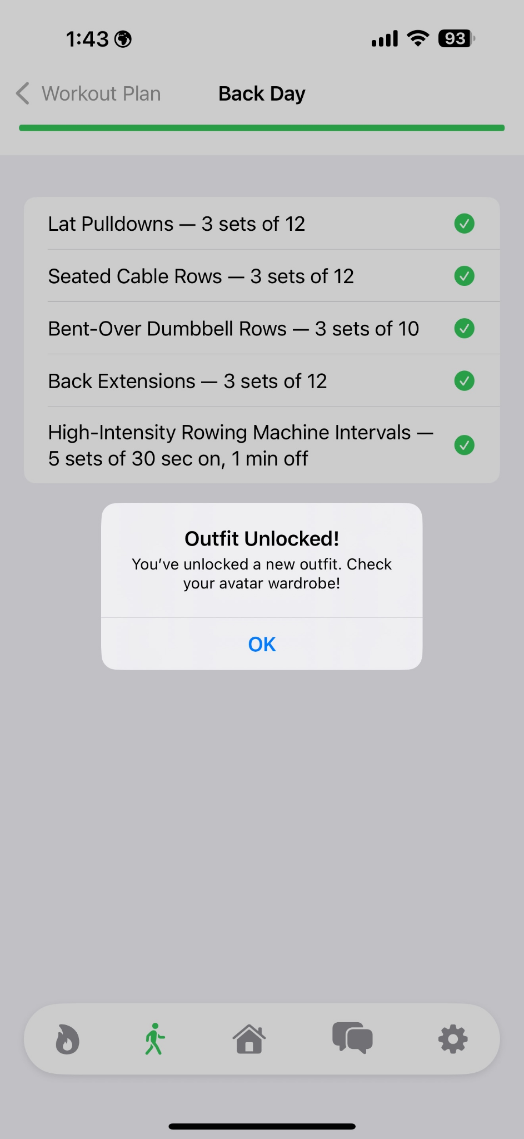
FitGenius
2024
:D
06
User Interface Design

Slide 15

FitGenius
2024
:D
07
Database Design
Requirement Definition:
The FitGenius database will securely store user profiles, workout logs, and gamification elements like achievements to support fitness tracking. It will ensure data integrity, scalability for thousands of users, and optimized performance for fast queries and updates. The design will comply with data protection regulations and support seamless integration with the app’s functionality.

Slide 16
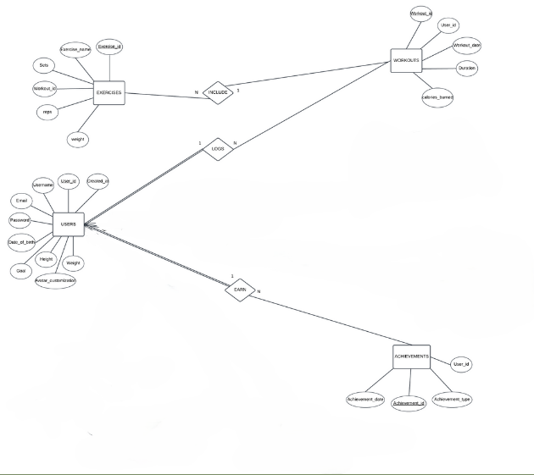
FitGenius
2024
:D
07
Entities:
Users
Workouts
Exercises
Achievements

Slide 17
FitGenius
2024
:D
07
Database Design
Achievements, enabling awarding badges, and redeeming points-based rewards, enhancing user engagement and retention.
Relationships between entities ensure accurate reporting for trends, while constraints validate input to maintain data accuracy.
Business Logic
The Users table ensures secure login with encrypted passwords and stores user-specific data to customize the fitness experience.
Workouts and Exercises tables allow users to log detailed workout data.

Slide 18
FitGenius
2024
:D
07
Database Design
Queries
Retrieve User Details
Update User Profile
Log a Workout
Retrieve Workout History
Get Weekly Workout Summary
View Progress Over Time
Retrieve User Achievements

Slide 19

FitGenius
2024
:D
08
Security Considerations
User Concerns:
Comply with HIPAA policies
Privacy Policy for transparency with users
Upload user data with user consent
Store processed as opposed to raw data

Slide 20

FitGenius
2024
:D
08
Security Considerations
Apple’s HealthKit Integration:
HealthKit encrypts stored data (iOS Data Protection)
HealthKit APIs to request user consent
Retrieve user activity data and process locally
Store in Firestore Firebase

Slide 21

FitGenius
2024
:D
08
Security Considerations
Firebase:
Firebase Authentication:
Supports email/password logins
Can implement MFA for enhanced security
Firebase Firestore:
Store health data in structured format
Encrypts data in transit and at rest (Transit: SSL/TLS, Rest: AES -256)

Slide 22
FitGenius
2024
:D
Thank You!
Any Questions?

